Slide 1
Advanced Computer Algorithms (3Hrs/Week) Prof. Bertrand M.T. Lin (林妙聰) Institute of Information Management National Chiao Tung University, Taiwan Time: BCD (Tuesday) Classroom: MB304

Slide 2
Contact Information: Office: MB310; Tel: 03-5131472; E-mail: bmtlin@nycu.edu.tw Office Hours: EF Wednesday TA: 錢玟卉 (IIM graduate student), Ext. 57419 mimi111236@gmail.com Lab: MB313B

Slide 3
Research Interest: Scheduling theory, Discrete optimization
Assembly-type flowshop batch scheduling subject to a fixed job sequence
Concurrent open shop scheduling with centralized and decentralized batching policies
Ant colony optimization for the dynamic routing and wavelength assignment in WDM networks with sparse wavelength conversion
An effective approach for test-sheet composition from large-scale item banks
Optimal scheduling in film production to minimize talent hold cost
Minimizing the makespan in three-machine assembly type flow shop problem
Relocation problems

Slide 4
Source of Materials
T.H. Cormen, C.E. Leiserson, R.L. Rivest and C. Stein, Introduction to Algorithms, 3rd Ed., MIT Press, 2008.
Lee, R. C. T. Chang, R. C. Tseng, S. S. and Tsai, Y. T., Introduction to the Design and Analysis of Algorithms: A Strategic Approach, McGraw Hill, 2005.
M.R. Garey and D.S. Johnson, Computers and Intractability: A Guide to the Theory of NP-Completeness, 1979, Freeman W.H.
G. Ausiello, P. Cresenzi, G. Gambois, V. Kann, A. Marchetti-Spaccamela, and M. Protasi, Complexity and Approximation: Combinatorial Optimization Problems and Their Approximability Properties, Springer-Verlag, 2003, Germany.
P. Schuurman and G.J. Woeginger, Approximation schemes,: A tutorial, included in Lectures on Scheduling by R.H. M¨ohring, C.N. Potts, A.S. Schulz, G.J. Woeginger, L.A. Wolsey.
Selected Articles

Slide 5
Research Methodologies
Computationally Challenging
Developing
Exact Methods
Modeling and
Formulation
Settling Time
Complexity
Developing Approx.
Methods

Slide 6
Research Methodologies
Branch-and-
Bound Algorithm
Developing
Exact Methods
Dynamic Prog.
Algorithm
1. Development of Structural Properties,
such as Optimality Property, Dominance/
Elimination Rule, Bounding functions
2. Computational Assessment

Slide 7
Research Methodologies
Approximation
Schemes
}
Error Analysis
Develop Approx.
Methods
Heuristic
Methods
}
Computational
Assessment
Meta-Heuristic
Methods

Slide 8
Course Outline
Growth of Functions and Computational Complexity
Design and Analysis of Algorithms – Divide and conquer, heap sort and quick sort
Greedy Algorithms
Theory of NP-completeness
Dynamic Programming
Branch-and-bound
Approximation Algorithms
(Fully) Polynomial Time Approximation Schemes Algorithms (PTAS and FPTAS)
Meta-Heuristics

Slide 9
Grading
Homework & programming assignment 40%
Paper presentation 15%
Term project 35%
Participation 10%

Slide 10
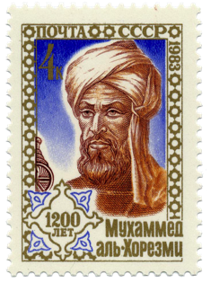
Algorithms
Al-Khwarizmi, a Persian mathematician around c. 780 – c. 850, was translated as Algoritmi or Algaurizin
In mathematics and computer science, an algorithm is a step-by-step procedure for calculations. (Wiki)
An algorithm is an effective method expressed as a finite list of well-defined instructions for calculating a function. (Wiki)

Slide 11
Why to Study Algorithms?
有用 vs. 無用
The primary reason is to enable readers to use computers efficiently. A novice programmer, without good knowledge of algorithms, may prove to be a disaster to his/her boss and the organizations where he/she works. (RCT Lee et al. 2005)
新知識的追尋：黃一農院士
https://www.youtube.com/watch?v=SVXWon6QNqo

Slide 12
When errors emerge, even just a single one out of 10¹⁰⁰ trials, what would you think about the source of the errors?
Bad luck or unknown spirits
Rounding/truncation errors
Bugs in programs/codes
Flaws in algorithms
Wrong or unclear specifications

Slide 13
S. Sloman, P. Fernbach, The Knowledge Illusion: Why We Do Not Think Alone

Slide 14
Minimum Spanning Tree
1
5
11
9
2
12
7
15
13
4
3
14
11
1
9
5
2
7
12
13
11
3
14
1
9
2
5
12
15
13
4
14

Slide 15
Minimum Spanning Tree
Given is a weighted graph,
find a minimum spanning tree
describe the solution algorithm
are you sure if the algorithm gives a correct answer
determine if a cycle emerges when a new edge is added
implement the algorithm
what is the required run time of the algorithm, subject to your implementation

Slide 19
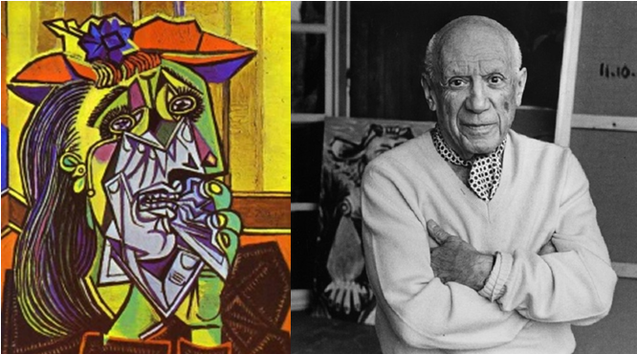

Slide 20
Computing Theory

Slide 21
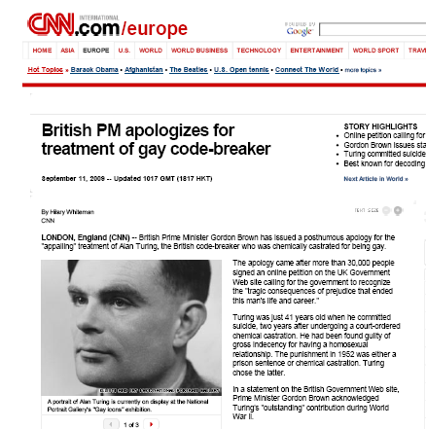
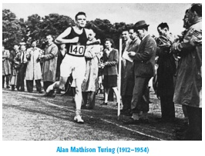
The Imitation Game
2009

Slide 22
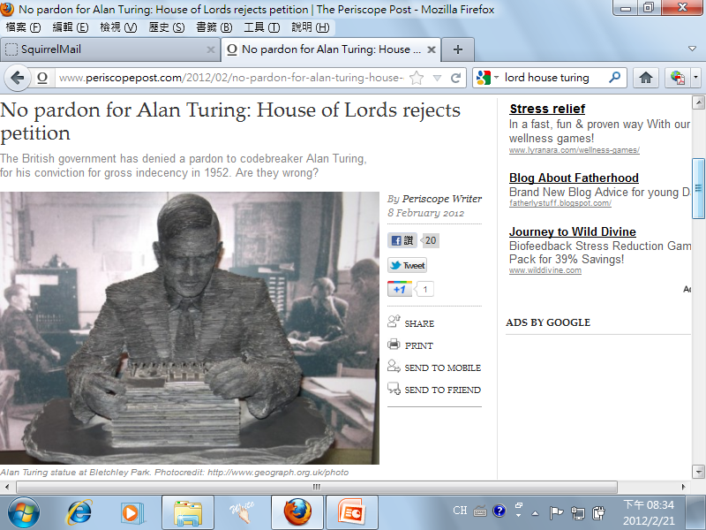

Slide 23
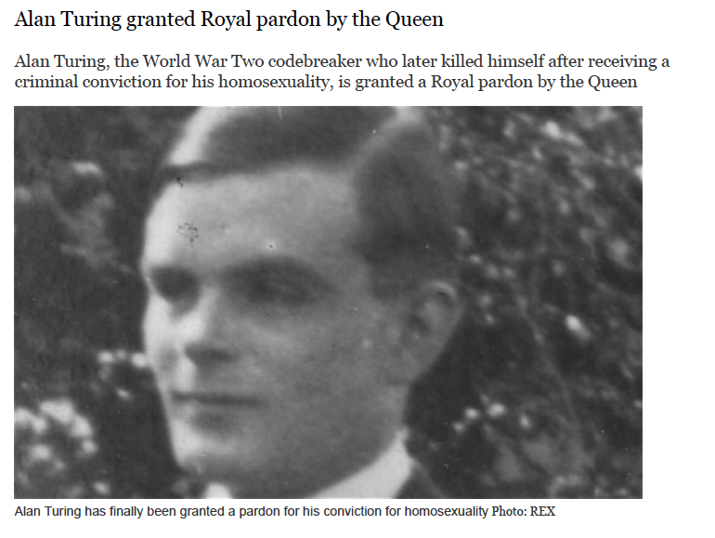
2013

Slide 24
Turing Machine
Who was Alan Turing?
Founder of computer science, mathematician, philosopher, codebreaker, strange visionary and a gay man before his time. (http://www.turing.org/turing)
A.M. Turing Award (presented by ACM since 1966)

Slide 25
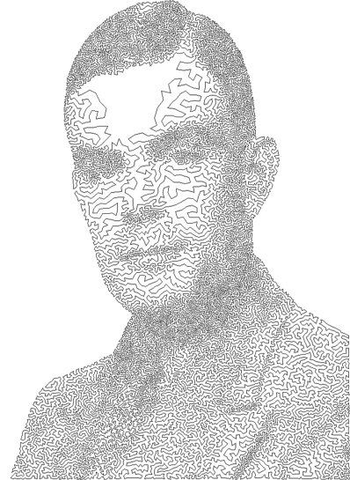
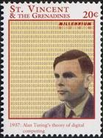
A.M. Turing Award - Nobel Prize of Computer Science
ACM's most prestigious technical award is accompanied by a prize of $250,000 (originally, $100,000). It is given to an individual selected for contributions of a technical nature made to the computing community. The contributions should be of lasting and major technical importance to the computer field. Financial support of the Turing Award is provided by Intel and Google (originally, by Intel only).

Slide 26
Turing’s Thesis (A.P. Parkes, 2002)
Any computation that can be realized as an effective procedure can also be realized by some Turing machine
There is no machine (either real or abstract) that is more powerful, in terms of what it can compute, than the Turing machine
The computational limitations of the Turing machine are the least limitations of any real computer

Slide 27
Turing Machine
Tape
b
1
0
b
1
0
1
b
TM: (Σ, Q, T, δ, q₀, F)
Σ: input alphabet
Q: finite set of states
T: set of symbols on the tape
q₀: start state
F: set of final states; F is a subset of Q
δ: transition function; Q×T→ Q×T×{-1, 0, +1}
R/W Head
Finite State
Automata

Slide 28
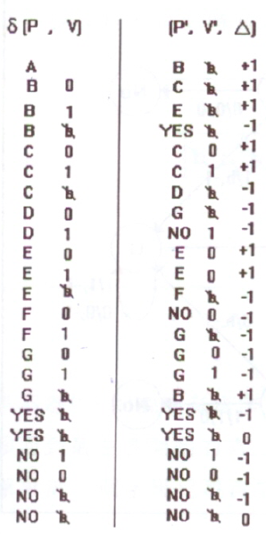
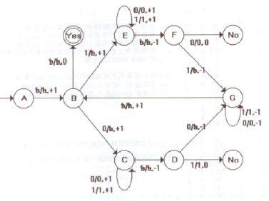
b
1
0
1
1
0
1
b
出處：王立天，Automata 您別跑!
Automata and Formal Language 導論，
靖宇科技出版，1994年。

Slide 29
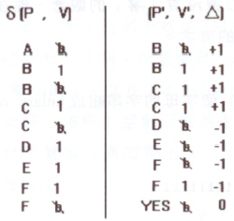
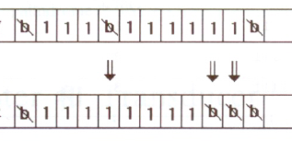
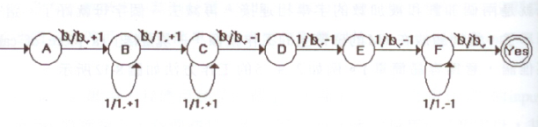
出處：王立天，Automata 您別跑!
Automata and Formal Language 導論，
靖宇科技出版，1994年。

Slide 30
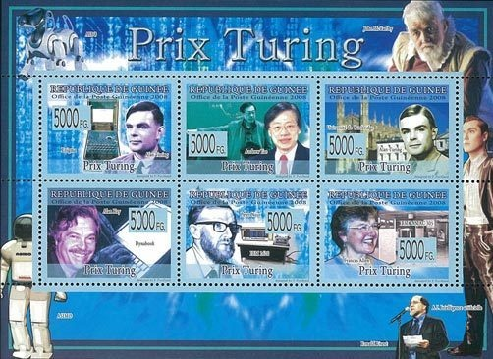
Award Winners
2019: P.M. Hanrahan, E.E. Catmul (3D Computer graphics)
2018: Y. Bengio, G. Hinton, Y. LeCun (Deep Neural Networks)
2017: J.L. Hennessy and D. Patterson (Computer architectures)
2016: T. Berners-Lee (WWW)
2015: W. Diffie and M. Hellman (public-key cryptography)
2014: M. Stonebraker (Database, INGRES)
2013: L. Lamport (theory and practice of distributed and concurrent systems)
2012: S. Goldwasser and S. Micali (complexity theory in cryptography, proof verification)
2011: Judea Pearl (artificial intelligence: calculus for probabilistic and causal reasoning)
2010: Leslie G Valiant (theory of computation, theory of parallel & distributed computing)

Slide 31
Award Winners
2009: C.P. Thacker (PC, Internet and tablet PC)
2008: B. Liskov (PL and System Design)
2007: B.H. Liskov (PL and System Design)
2006: F.E. Allen (Optimizing Compiler)
2005: P. Naur (PL)
2004: V.G. Cerf and R.E. Kahn (TCP/IP)
2003: Alan Kay (Smalltalk: OO)
2002: R.L. Rivest, A. Shamir and L.M. Adleman
2001: O.-J.Dahl and K. Nygaard (Simula I, Simula 67: OO)
2000: A. Chi-Chih Yao (Theory of Computation)
1983: K. Thompson and R.M. Ritchie (UNIX)
M. Minsky (1969), J. McCarthy (1971), D.E. Knuth (1974), A. Newell (1975), S.A. Cook (1982)

Slide 32
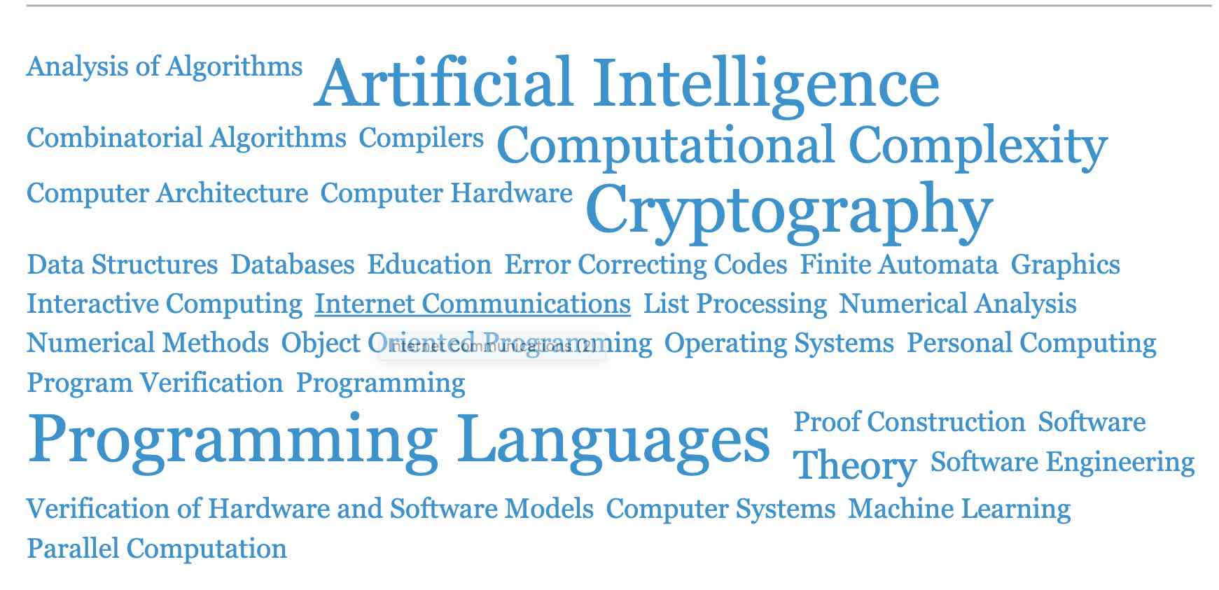
Turing Award by Subjects
(source: www.acm.org)

Slide 33
Chang, C.L., & Lee, R.C.T. (1969). Symbolic Logic and Mechanical Theorem Proving. Academic press.
http://www.nicesoftsearch.com/bio.html

Slide 34
expert systems
speech recognition
pattern recognition
machine learning
natural language processing
mathematical logic
If p Then q
Artificial Intelligence
e.g., mathematical induction
If {f(1) and
{for k>1, If f(k)
Then f(k+1)}}
Then {f(n) for all n > 0}
neural network
fuzzy theory
statistics

Slide 35
ERP-II
MRP
ERP
decision support
systems
Optimization tools
Optimization
for economic activities
Optimization
Linear programming
simplex algorithm
algorithms and methods
(dynamic programming,
meta-heuristics, …)

Slide 36
Business Analytics Applied Analytics
Artificial Intelligence
Optimization

Slide 37
0/1 Knapsack problem
M(weight limit)=14
best solution: P₁, P₂, P₃, P₅ (optimal)
This problem is NP-hard
 | P₁ | P₂ | P₃ | P₄ | P₅ | P₆ | P₇ | P₈
Value | 10 | 5 | 1 | 9 | 3 | 4 | 11 | 17
Weight | 7 | 3 | 3 | 10 | 1 | 9 | 22 | 15

Slide 38
Traveling salesperson problem (TSP)
Given a set of points with a distance between each two points, TSP seeks to find a closed tour which includes all points exactly once such that its total length is minimized
TSP is NP-hard
4
4
7
8
Starting
node
5
2
6
3

Slide 39
Partition problem
Given a set of positive integers S, find a partition S₁ and S₂ ( S₁∩S₂=∅, S₁∪S₂=S) such that
e.g. S={1, 7, 10, 4, 6, 8, 13}
S₁={1, 10, 4, 8, 3}
S₂={7, 6, 13}
This problem is NP-complete.

Slide 40
Art Gallery Problem
Given an art gallery, determine min # of guards and their placements such that the entire art gallery can be monitored.
NP-hard

Slide 41
Minimum spanning tree
Graph: greedy method
Geometry (on a plane): divide-and-conquer
# of spanning trees for n points is n^{n-2}

Slide 42
Convex hull
Given a set of planar points, find a smallest convex polygon which contains all points
It is not obvious to find a convex hull by examining all possible solutions
divide-and-conquer

Slide 43
One-center problem
Given a set of planar points, find a smallest circle which contains all points.
Prune-and-search

Slide 44
While some simple questions that are difficult to provide answers to, some sophisticated problems are easy to be resolved!
How do we determine whether or not a problem is difficult?

Slide 45
Easy-to-read Pioneering Papers
R.L. Rivest, A. Shamir, and L. Adleman (1978) A method for obtaining digital signatures and public-key cryptosystems. Communications of the ACM, 21 (2), 120-126.
D. Gale and L.S. Shapley (1962). College admission and the stability of marriage. The American Mathematical Monthly, 69 (1), 9-15.

